Slide 1
Add Holds and Hatches

Slide 2
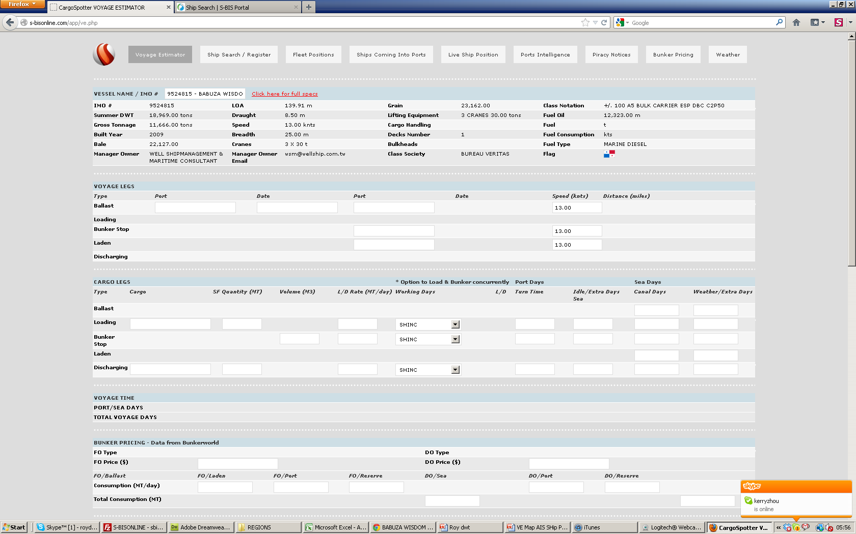
We need to add this data to
HOLDS: | 4 (tot 23.060 m3)
LARGEST HATCH: | LENGTH 17.50 m BREADTH 15.00 m

Slide 3
